Slide 1

AI-Powered Real-Time Theft Detection System for Shopping Malls
Group Members:
Muhammad Nadeem(22P-9366)
Laiba Shahi(22P-9247)
Sultan Mehmood Mughal(22P-9242)
Project Supervisor
Dr. Hafeez Anwar

Slide 2
Introduction
An AI-powered theft detection system analyzes CCTV footage to identify suspicious activities in real time, ensuring quick alerts and enhanced mall security through intelligent automation.
Why AI for Theft Detection?
Efficient Video Processing – Handles multiple CCTV feeds simultaneously.
Real-Time Action Recognition – Detects theft-related behaviors instantly.
Faster, Accurate Alerts – Reduces human error and improves response time.

Slide 3
Problem Statement
Current shoplifting detection systems often fail in shopping malls due to small datasets, occlusion, and crowded scenes. They also struggle to detect multiple thefts under one camera, leading to missed or inaccurate alerts. Therefore, a reliable deep learning-based system is needed to detect multiple thefts accurately in real time, even in complex mall environments.

Slide 4
Primary Objective
To design an intelligent system that can accurately detect and recognize multiple shoplifting incidents in real time within shopping malls.
Specific Objectives
To create an intelligent model that identifies hiding products in pockets activities in mall surveillance videos.
To ensure reliable detection even in crowded areas with occlusion and clutter.
To improve accuracy and performance using a large, diverse shopping mall dataset.
To generate instant alerts for multiple thefts occurring under a single camera in real time.

Slide 5

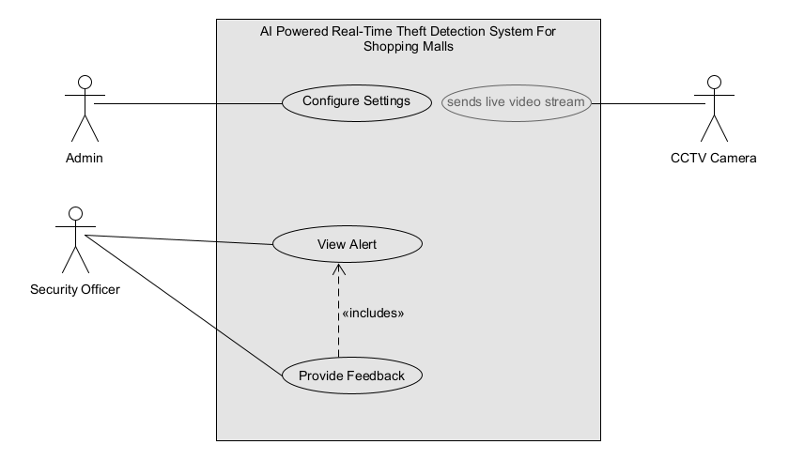
Use-Case Diagram

Slide 6

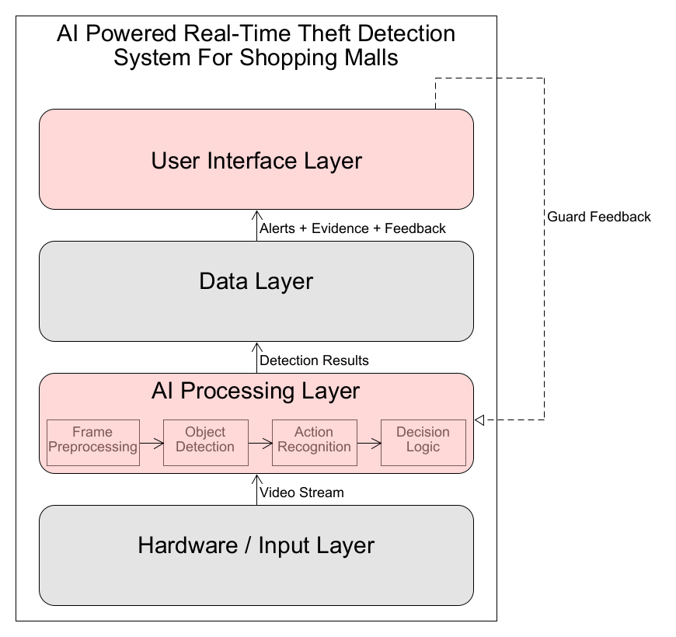
System Architecture Diagram

Slide 7
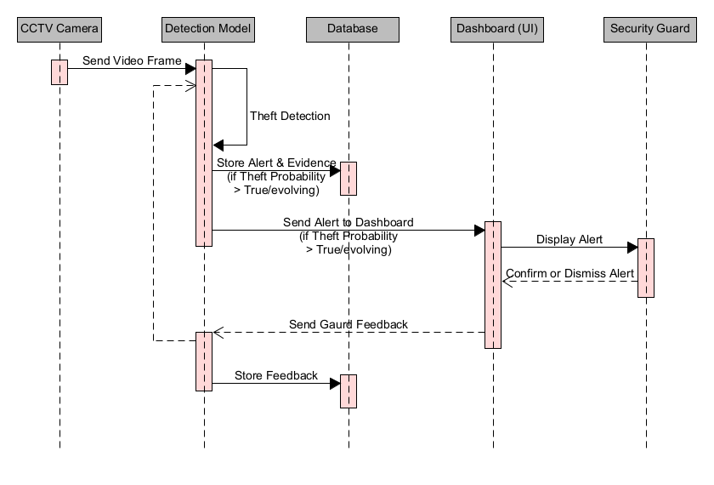
Sequence Diagram

Slide 8
Methodology
Dataset Collection
8 Persons
Different Angles (per scene)
Distance variations
Lighting
Poses / actions
Clothing variations

Slide 9
Pre-Processing
Raw data to clips(hiding/normal)
Frames extraction from each clip
Resizing frames
Labeling
Frames cropped for model training

Slide 10



Preprocessing Pipeline
RAW VIDEO
Creating Clips(Hide/Normal)
Frames Extraction
Cropping Frames
Labeling
Resize Frames

Slide 11
Tool & Models
MoveNet (Pose Estimation)
LSTM (Action Recognition)
Python Tools
such as:
TensorFlow / TF-Hub - MoveNet
OpenCV - video processing
NumPy - dataset handling
Google Colab / Jupyter Notebook

Slide 12
TRAINING PIPELINE
Cropping
(focus on person)
Resize & Normalize (image preprocessing)
MoveNet Model Pose Estimation (17/33 KP)
Raw Videos
LSTM Train (Theft/Action Recognition)
Sequence Builder (N frames → 1 sample)
JSON/CSV Keypoints (per-frame data)

Slide 13
TESTING PIPELINE
(crop using YOLO box)
YOLO Detector (Finds Person + B Boxes)
Cropped Person Image (ROI extracted by YOLO)
MoveNet Pose Estimation (KP)
Live Video Feed / Test Video
LSTM Predict: Theft / Normal
Keypoint Sequence (buffer of last N frames)
Generate Alert

Slide 14
MoveNet MultiPose Lightning
A fast and lightweight human pose estimation model by Google.
What it does
Detects 17 key body joints (head, shoulders, elbows, hands, hips, knees, ankles).
Enables real-time multi-person pose detection through TensorFlow Hub.
Provides keypoint coordinates + confidence scores.
Real-time performance (runs on CPU/GPU)
Produces clean keypoints suitable for LSTM training
Output Format
JSON/CSV keypoints per frame → used by LSTM

Slide 15
MoveNet MultiPose Lightning
Feature | Description
Model Name | MoveNet MultiPose Lightning
Version | v1
Publisher | Google / TensorFlow Hub
Task | Multi-person 2D human pose estimation

Slide 16
KeyPoints Description
0: nose
1: left eye
2: right eye
3: left ear
4: right ear
5: left shoulder
6: right shoulder
7: left elbow

Slide 17
8: right elbow
9: left wrist
10: right wrist
11: left hip
12: right hip
13: left knee
14: right knee
15: left ankle
16: right ankle

Slide 18
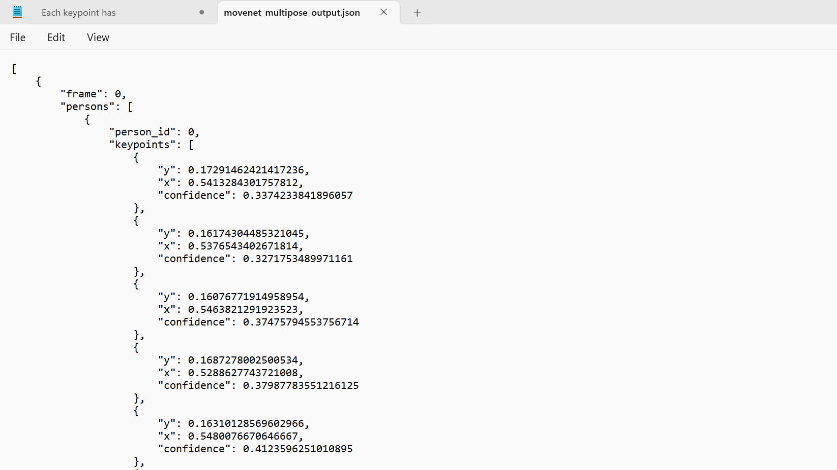
Output Format(JSON/CSV keypoints)

Slide 19
LSTM
Why LSTM?
Human movement is sequential.
LSTM learns patterns over time (not just per frame).
How it works :
Uses 3 gates: Forget, Input, Output
Keeps useful information, removes useless, and updates memory.

Slide 20
Input to LSTM:
Multiple frames form a sequence → LSTM input.
Each frame → 17 keypoints → (x, y, score) → 51 features per frame
Output:
Predicts normal vs suspicious movement.

Slide 21
SOFTWARE DEVELOPMENT PLAN
Using Agile Scrum
Each Sprints (2 months):-
Sprint 1: Literature Overview and UML Diagrams
Sprint 2: Movenet model
Sprint 3: LSTM design
Sprint 4: Models Testing
Sprint 5: Final Thesis + Report

Slide 22
Algorithm Design
Pose Extraction (Movenet)
Feature Encoding (Flatten )
LSTM
Alert Generation Logic

Slide 23
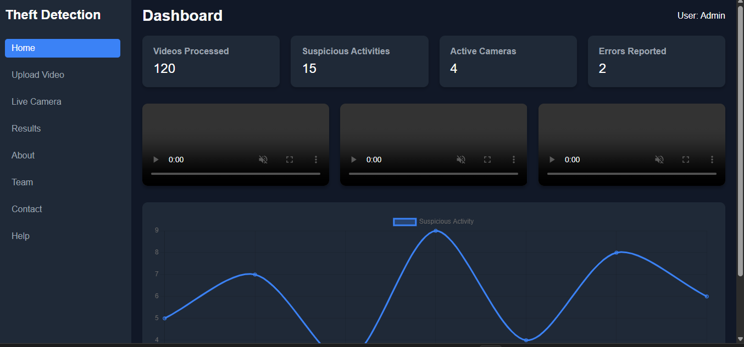

Slide 24
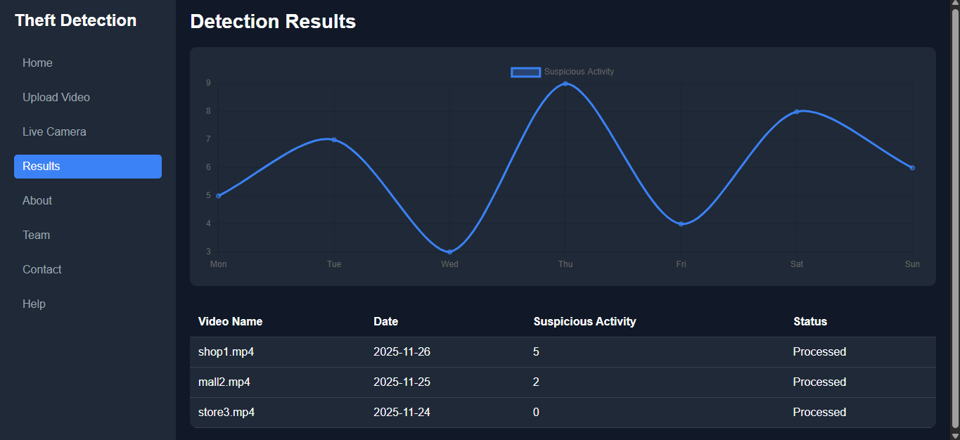

Slide 25
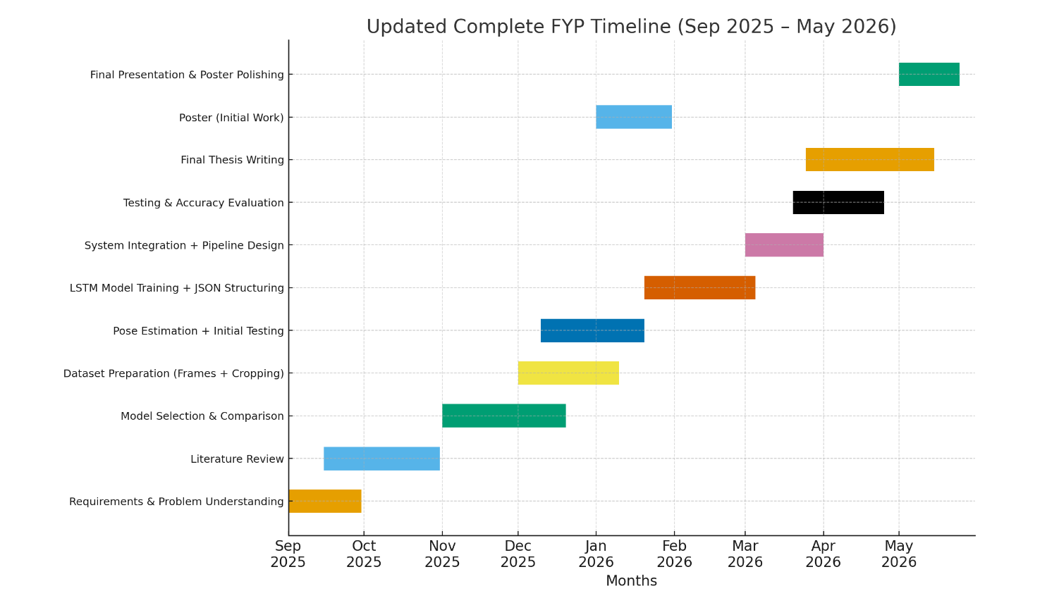
Gantt Chart

Slide 26
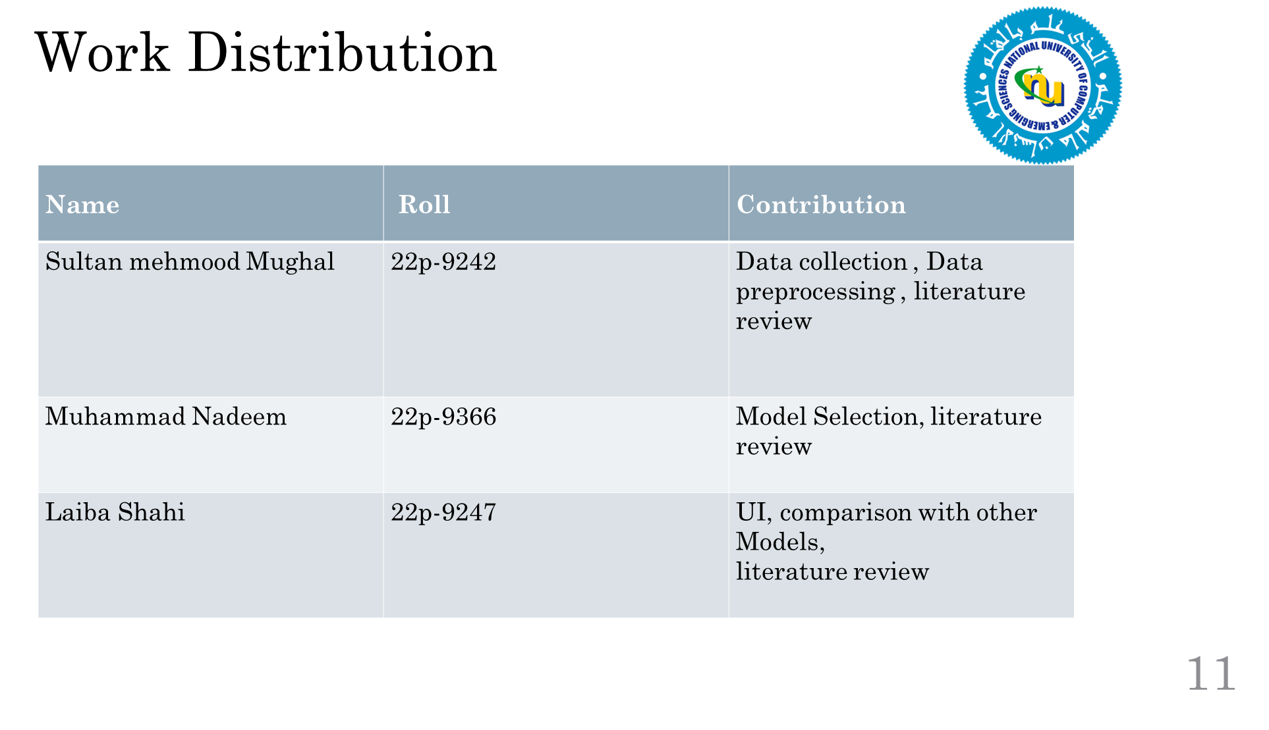

Slide 27
Thank You

Slide 28
References
[1] Rashvand, N., Noghre, G.A., Pazho, A.D., Yao, S. and Tabkhi, H., 2025. Exploring Pose-Based Anomaly Detection for Retail Security: A Real-World Shoplifting Dataset and Benchmark. In Proceedings of the Winter Conference on Applications of Computer Vision (pp. 1123-1131).
[2] Rashvand, N., Noghre, G.A., Pazho, A.D., Ardabili, B.R. and Tabkhi, H., 2025. Shopformer: Transformer-Based Framework for Detecting Shoplifting via Human Pose. In Proceedings of the Computer Vision and Pattern Recognition Conference (pp. 5752-5761).

